Slide 1
Collaborative practice through learning together to work together © CAIPE 2017
www.caipe.org
Supporting educators and practitioners in developing and delivering interprofessional education
Richard Gray, Jenny Ford & Emma Smith
Notes:
Richard

Slide 2
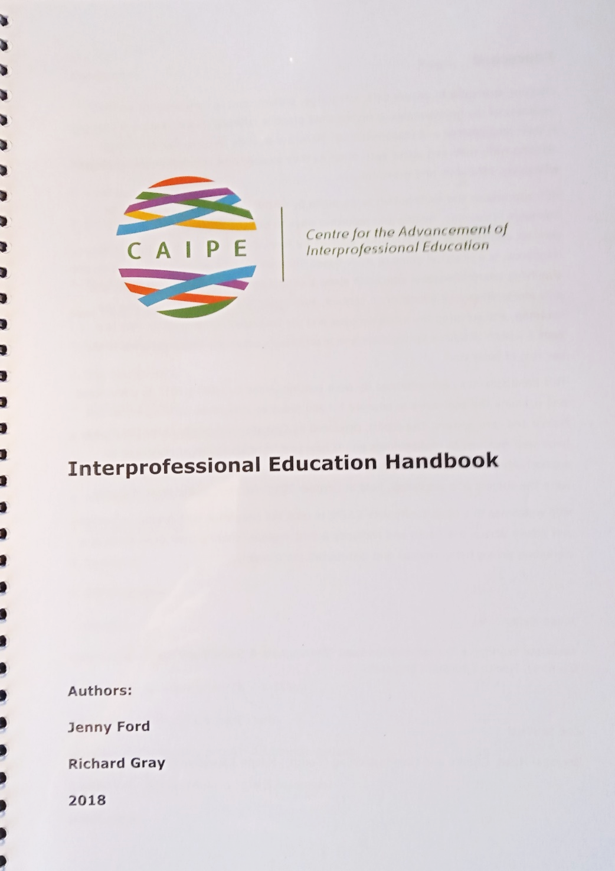
Introduction
Project to evaluate a new IPE Handbook
Pilot workshops in 3 NHS trusts; structured around the Handbook
The handbook is a succinct practical guide for busy practitioners focusing on developing and implementing IPE, with underpinning theory
Notes:
Richard

Slide 3
Collaborative practice through learning together to work together © CAIPE 2017
Overall project aims & background
Aims
To facilitate educators and healthcare practitioners develop knowledge and skills of IPE in practice
To facilitate the development of IPE champions
How did it come about?
Culmination of discussions between CAIPE and HEE
Commissioned by Health Education England (HEE)
Notes:
Richard
Health Education England (HEE) exists for one reason only: to support the delivery of excellent healthcare and health improvement to the patients and public of England by ensuring that the workforce of today and tomorrow has the right numbers, skills, values and behaviours, at the right time and in the right place.

Slide 4
Collaborative practice through learning together to work together © CAIPE 2017
Service user involvement
Handbook development
Workshop development
Co-facilitation of workshops
Independent observers for evaluation
Workshop participation
Notes:
Emma
2 service users reviewed the draft Handbook from a service user perspective and made changes
Equal member of facilitator group which write and revised the workshop
Co-facilitation of workshops – valued by participants – some surprised
Two neutral service users acted as observers and wrote reports for the evaluation
Intention that trusts and universities would invite service users to attend the workshops as participants – but none were present

Slide 5
Collaborative practice through learning together to work together © CAIPE 2017
Workshop set up
Project team of 3 worked interprofessionally throughout
Workshops planned to meet local needs - preliminary meetings with trusts and HEIs to prepare
Trusts/HEIs invited participants
Notes:
Emma

Slide 6
Handbook contents and workshop structure
Part One: Explaining IPE
What is meant by IPE? Evidence for the effectiveness of IPE Why do we need IPE? The theory behind IPE
Part Two: A guide to implementing IPE Collaborative planning Educational aims Learning activities Ensuring interprofessional engagement Venues and timings Facilitating the learning Promoting the IPE Evaluation IPE facilitators
Notes:
Richard

Slide 7
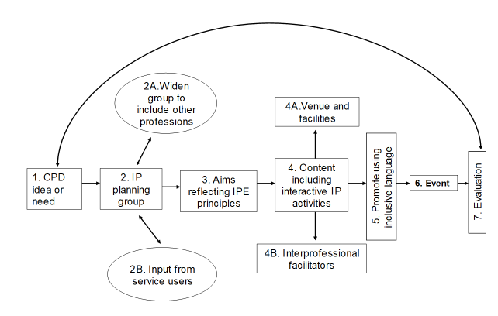
IPE planning flowchart
Notes:
Richard

Slide 8
Workshop participants
Previous IPE knowledge & experience: Ranged from none to highly experienced
Numbers: 35 across 3 workshops
Professions: nurses, midwives, OT, doctors, librarian, managers, physician associate, technical demonstrator, university lecturers, practice educators
Workplaces: Practice and Universities
Seniority: From masters students to senior managers
Notes:
Emma

Slide 9
Collaborative practice through learning together to work together © CAIPE 2017
Evaluation - Action Research
Data collected: Pre- and post-workshop participant self assessment; post workshop feedback; observer feedback; facilitator reflections; examples of workshop notes and activities
Free text analysed thematically
Improvements made between workshops
Recommendations for larger scale delivery
Notes:
Jenny
Evaluation was part of our brief
We took an action research approach making improvements after each workshop
We collected pre and post workshop data from participants who assessed themselves against the learning outcomes.
We collected post workshop evaluations from participants
We also wrote out own reflections and had reported from an independent service user observer
The free text data were analysed thematically – participants said some interesting things which we wanted to capture
Based on our data we made some recommendations for larger scale roll out

Slide 10
Results - Flavour of post workshop data
What I learned
How I learned
How I will apply my learning
More confident
What IPE is
Skills for implementing IPE
From practical activities
Approach IPE differently
Apply IPE in my role
Theories behind IPE
Learning with others
I will use the tools
About others
Quality of the workshop
“Good workshop”
Suggestions
Notes:
Jenny
Points to make:
Handbook very positively received especially flowchart
Analysis took data apart but we learned that a combination is important – learning together interprofessionally; time to interact; having tools to take away; serious time to practise applying tools and think about own needs
We were surprised at the depth of learning reported and interest in theory
Interesting that learning about others emerged as a theme

Slide 11
Quotes
(Best aspects…) “…lots of group activity and applied learning from the morning into a useful exercise in the afternoon” (Milton Keynes)
“IPE planning flow chart extremely useful both to me and wider team” (Milton Keynes)
“Service user input very useful and refreshing” (Oxford)
“Going to make a personal goal to develop a team to develop an ethos for further IPE within the school/university” (Aylesbury)
“It was an excellent chance to meet other professionals from different backgrounds and exchange ideas about teaching/learning” (Aylesbury)
”Great Handbook” (Aylesbury)
Notes:
Emma and Jenny

Slide 12
Conclusions & recommendations
There is still a need for education about IPE
Handbook very positively received – best introduced through a workshop
Important to:
Ensure time to explore interprofessionally and to practise applying the ideas and tools
Provide participants with opportunity to identify needs in their own settings and start planning
Important to align workshop to local priorities and to demonstrate senior management support
Notes:
Jenny
Note: for this presentation stress usefulness of handbook and how it was central to workshop – practical activity enabled participants to identify possible projects
Building relationships – effective two-way communication between workshop team, host organisation and partner HEIs needed; align workshop to service priorities; promote workshop effectively and support staff to attend put this last as specific to UK context
Workshop content – customised to local needs; combination of workshop and Handbook with guidance for practical activities more stress on handbook
Workshop format – whole day; time for networking; extended practical session to apply learning to participants’ projects
Workshop facilitation – IP team including service user; model IPP; interactive style responsive to participants
Participants – combination of practitioners, practice educators and academics; should be a strategy for engaging service users and social care colleagues

Slide 13
Collaborative practice through learning together to work together © CAIPE 2017
Thank you for listening!
Richard Gray richard.gray@caipe.org
Emma Smith 3smithlet@gmail.com
Jenny Ford jsfjazz@gmail.com

