Slide 1


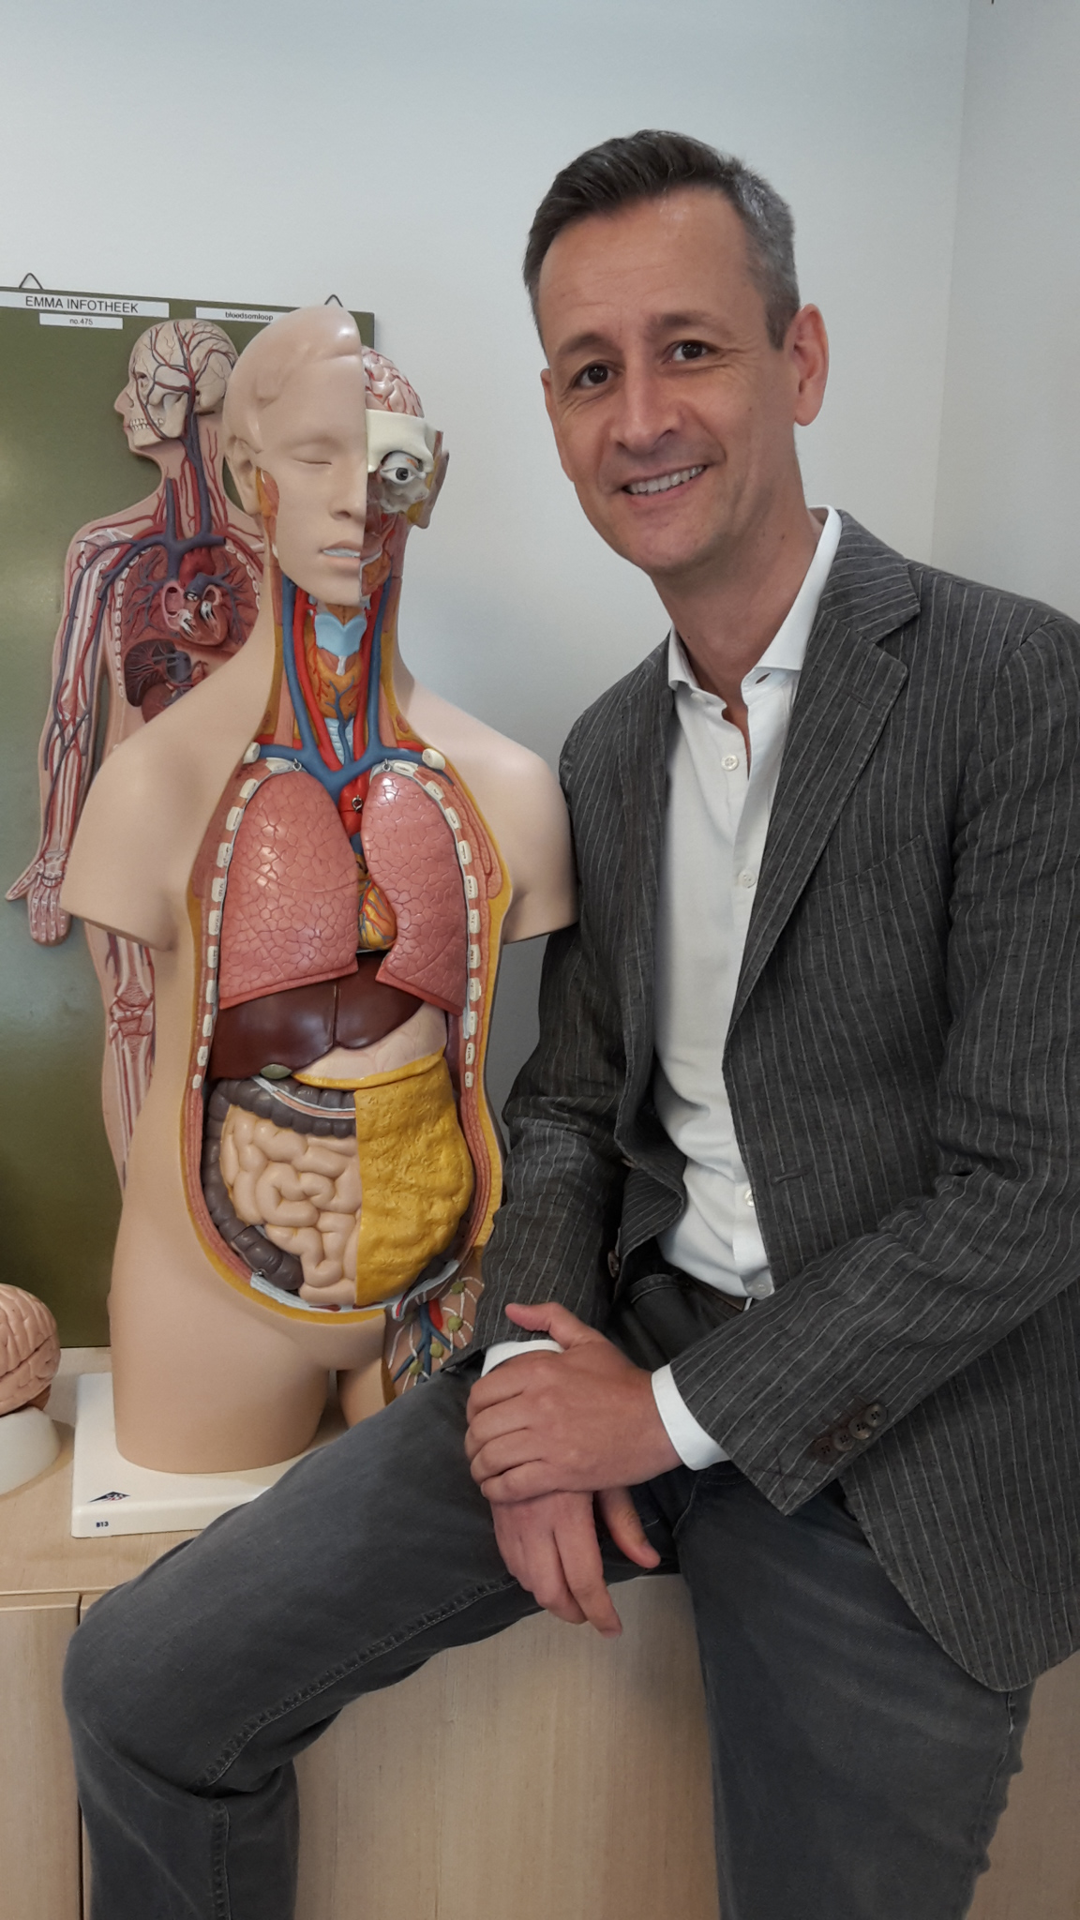

COVID-19-induced digitalisation & qualitative improvement of inter-institutional education in five healthcare curricula
Vincent Geukers MD PhD, paediatrician-intensivist, program leader IPE
Marike de Ruiter, Aline Broekema, Jan Hindrik van Ravesloot, Rien de Vos, Stephan Ramaekers, Margo van Hartingsveldt
Faculty of Medicine, Amsterdam Universities Medical Centre, University of Amsterdam
Faculty of Health, University of Applied Sciences Amsterdam
Amsterdam, The Netherlands

Slide 2


Disclosures
Grants:
  2019 Comenius Leadership Fellowship under auspices of
  the Royal Netherlands Academy of Arts and Sciences (KNAW)
  2020 Institute Interprofessional Studies, University of Amsterdam

Slide 3
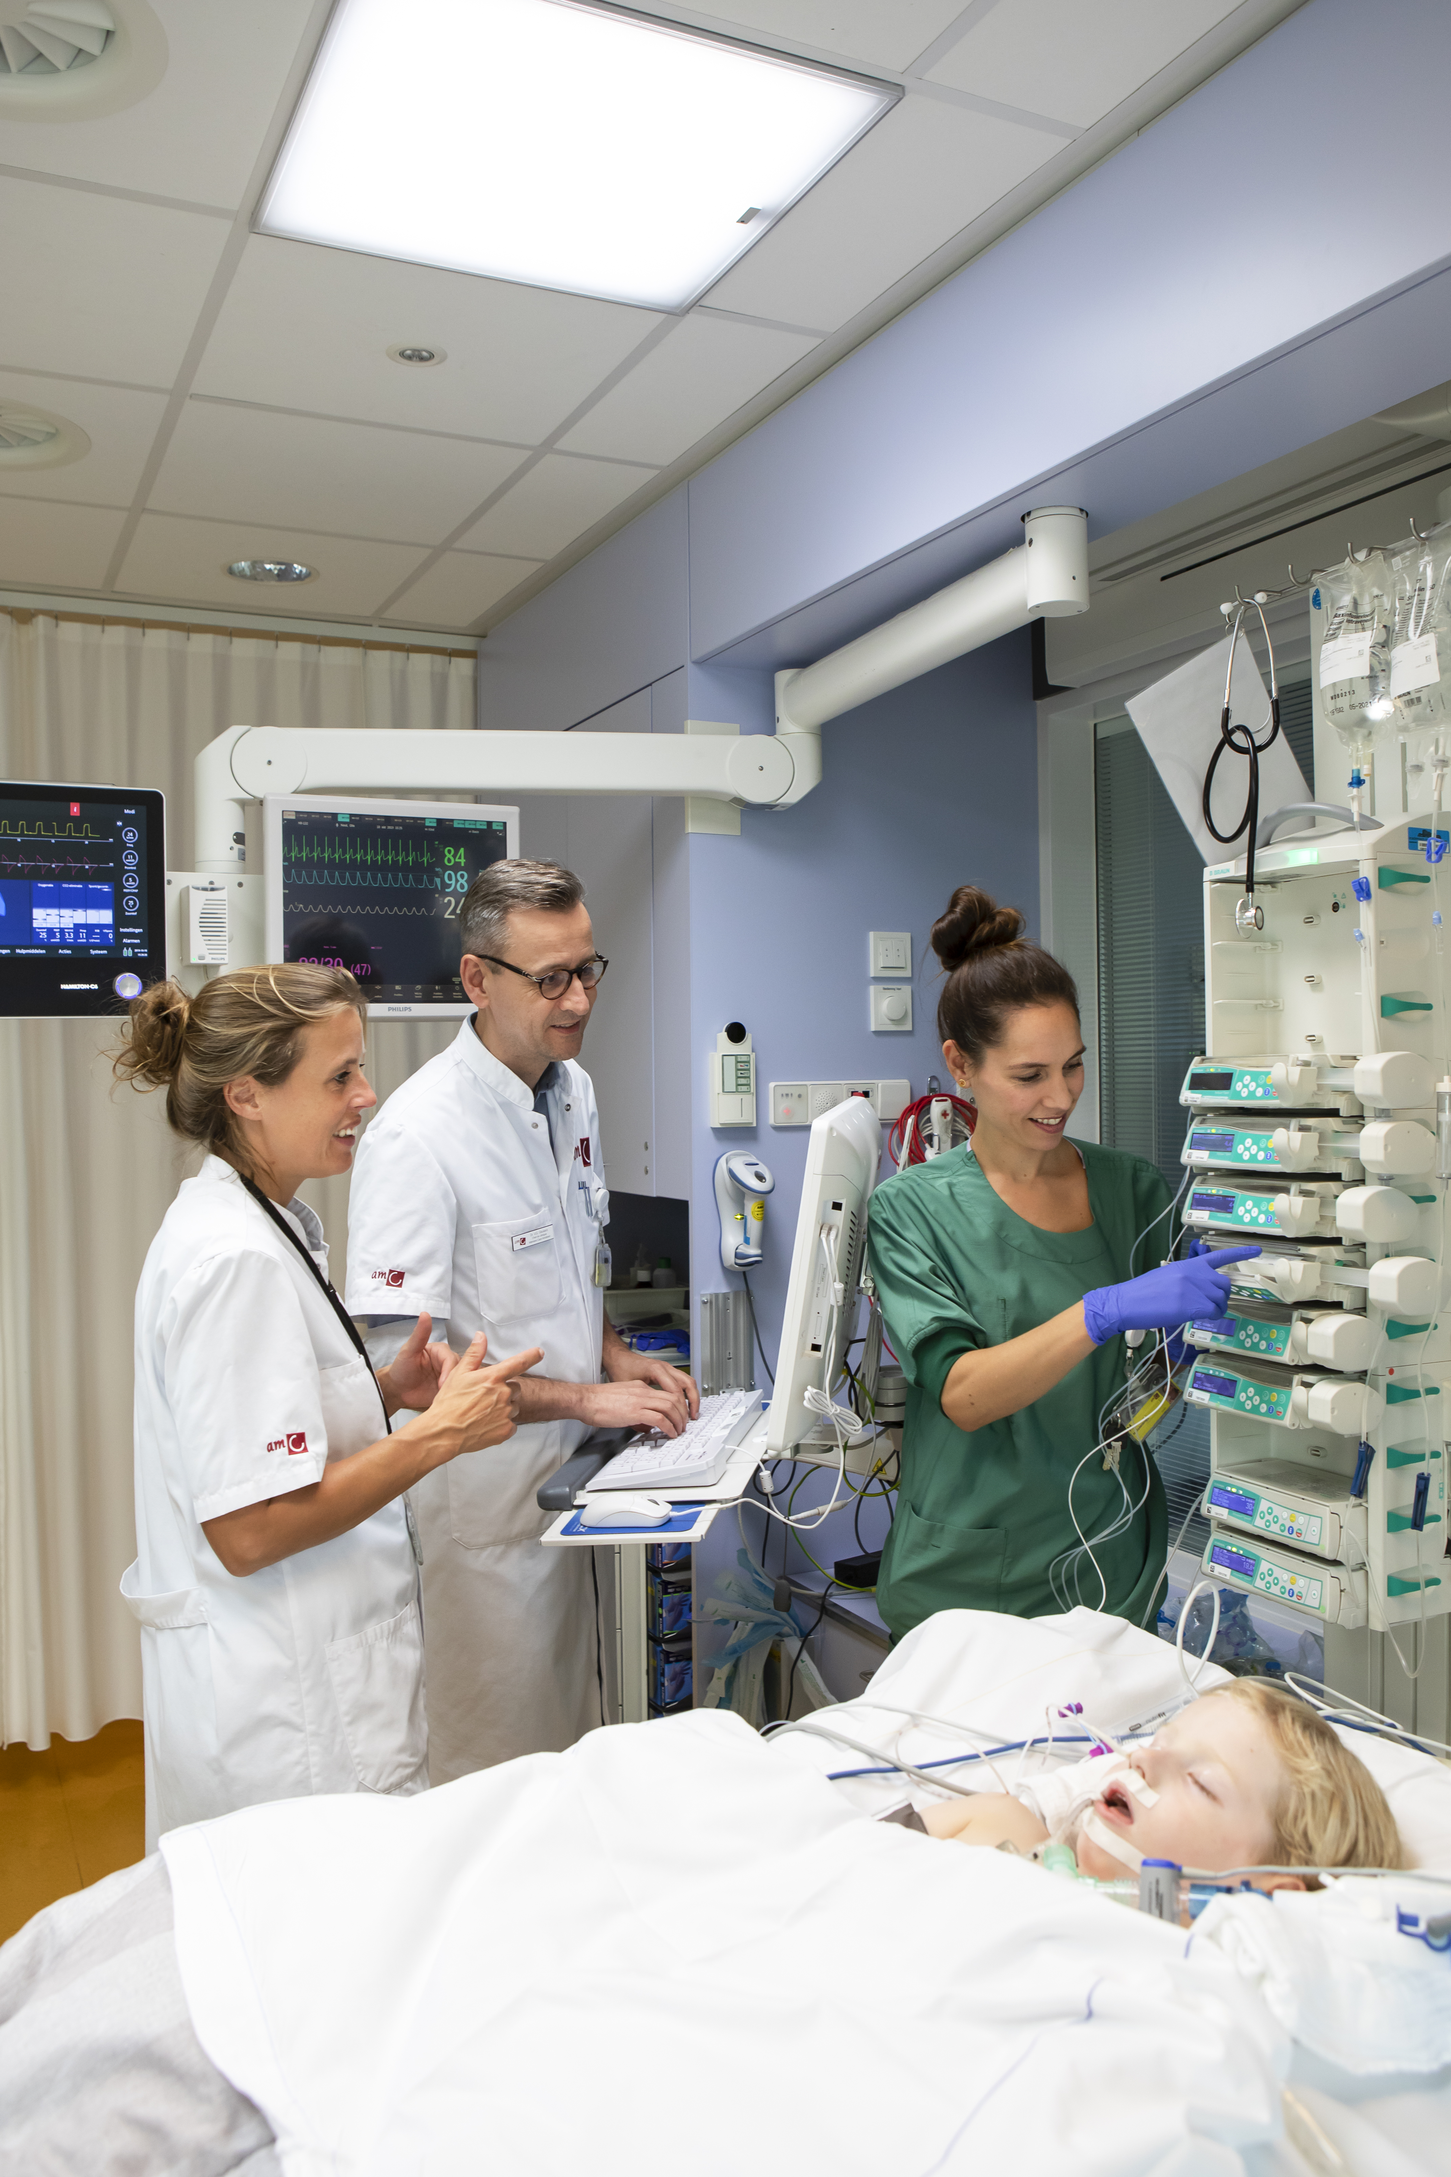
IPC networks
Modern healthcare has shifted towards interprofessional collaborative (IPC) networks of multi-located health professionals
  Integral and safe healthcare for patients
  More efficient healthcare at system level
  Cost reduction (?)

Slide 4
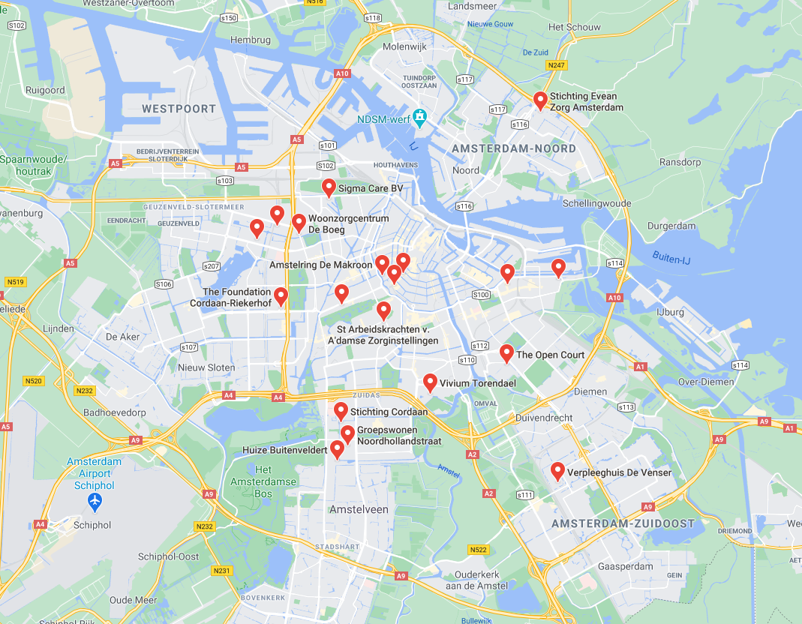
IPC networks
Modern healthcare has shifted towards interprofessional collaborative (IPC) networks of multi-located health professionals
  Integral and safe healthcare for patients
  More efficient healthcare at system level
  Cost reduction (?)
During the COVID-19 pandemic, and before, patients are transferred between hospitals, ICU’s, rehabilitation centres and home settings

Slide 5
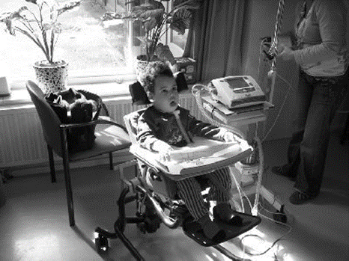
IPC networks: example
Parents, family, informal care
Paediatrician, neurologist, ENT
Physiotherapist, occupational therapist
Dietician, speech therapist
GP, pharmacist
CTB, specialized home care nurse
PGB, city council, transfer nurse
Social worker, psychologist
Educational service / school
Specialized transport company
…

Slide 6
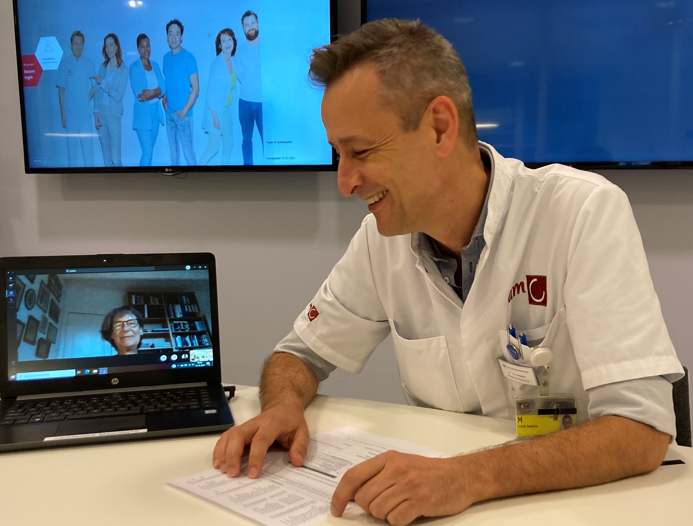
Digital IPC
Accelerated by COVID-19, health professionals increasingly collaborate by using digital means
Health students need to be better prepared for this new practice

Slide 7

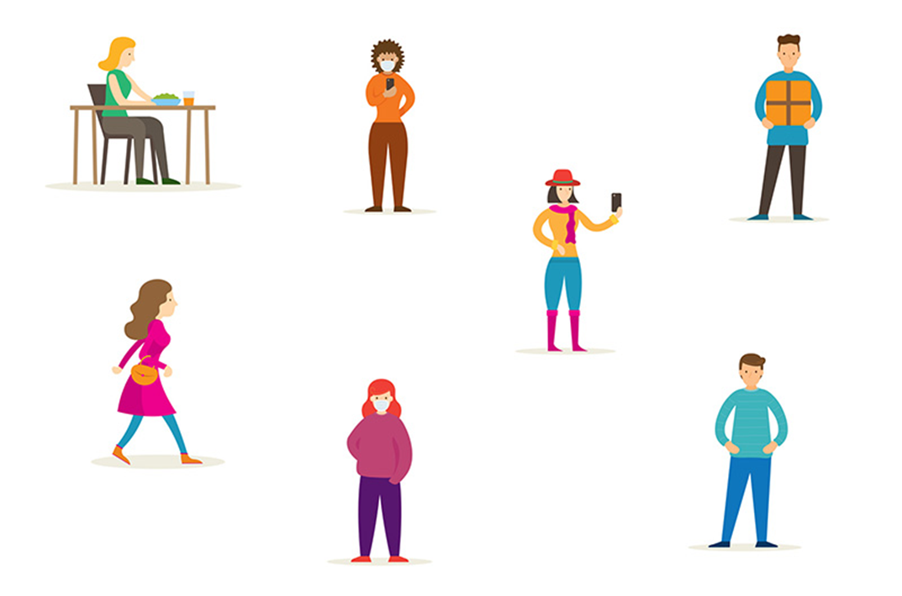

Digital IPE
Following COVID-19 regulations for education, the undergraduate IPE could not continue physically (later: social distancing)
Opportunity to redesign part of the IPE-course, aiming on training health students in digitalized IPC

Slide 8
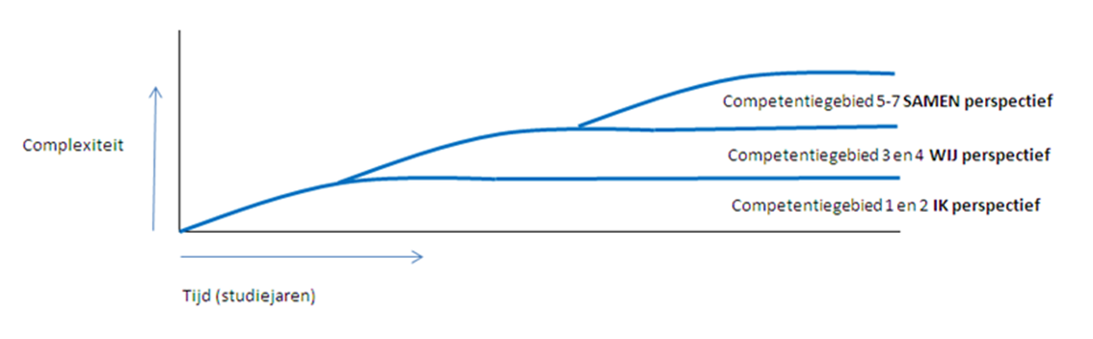
Amsterdam IPE program
I WE TOGETHER
Curricula:
Medicine
Nursing
Physiotherapy
Exercise therapy
Occupational therapy
Year 1 Years 2+3 Year 4 (=master medicine)
Observation IPC Simulation IPC in authentic IP-LWP’s

Slide 9
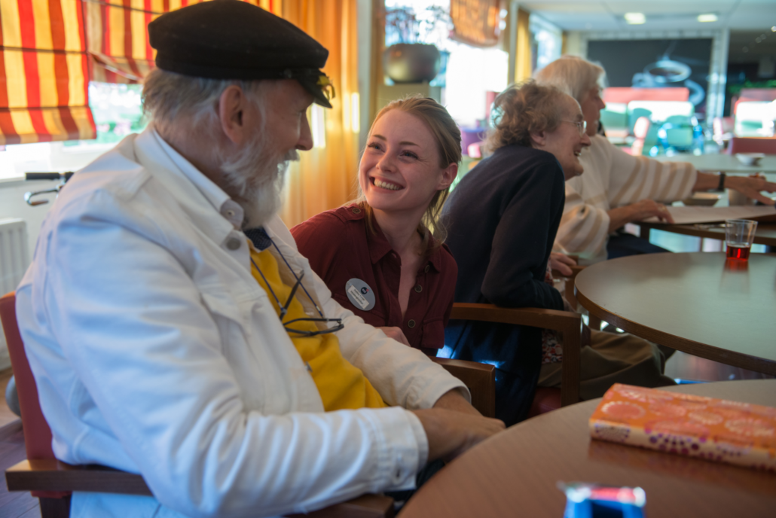
I phase: observation during internships
1
YEAR
What is the role of your future profession?
Who are the other players on the field?
What is their role?
Integration of care plan?
Transfer of leadership?
Common vocabulary?
Reflection on this experience?
Notes:
leiderschap in eigen professie en in teams herkennen & benutten
belangen van de patiënt kunnen meewegen bij elk besluit
tegenstellingen en conflicten herkennen & hanteren

Slide 10
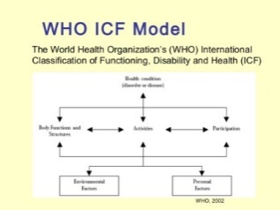
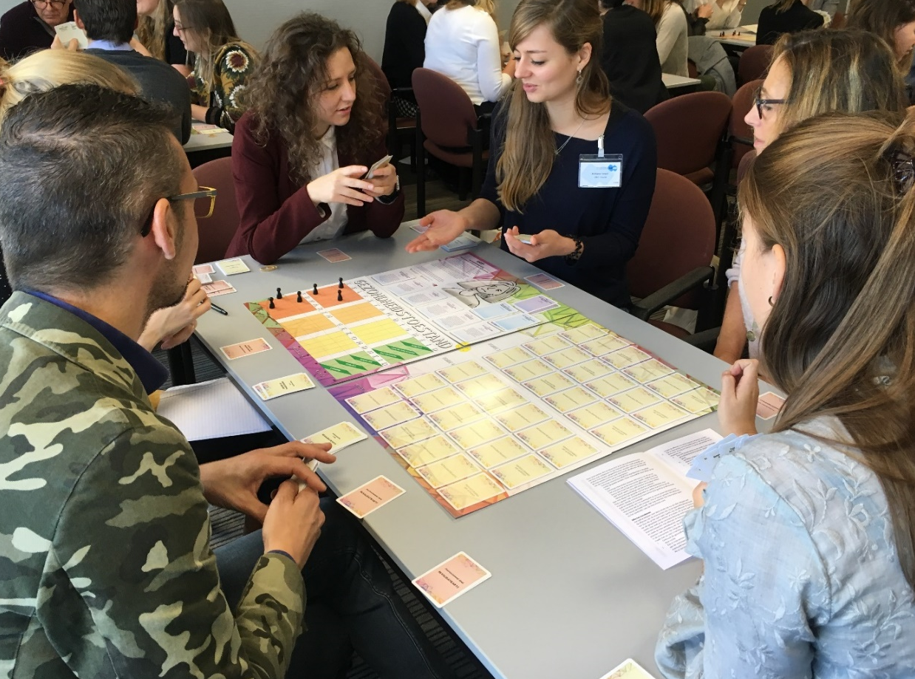
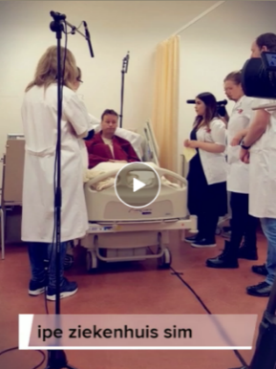
WE phase: 6x IPC simulation (blended)
2+3
YEAR
Notes:
leiderschap in eigen professie en in teams herkennen & benutten
belangen van de patiënt kunnen meewegen bij elk besluit
tegenstellingen en conflicten herkennen & hanteren

Slide 11
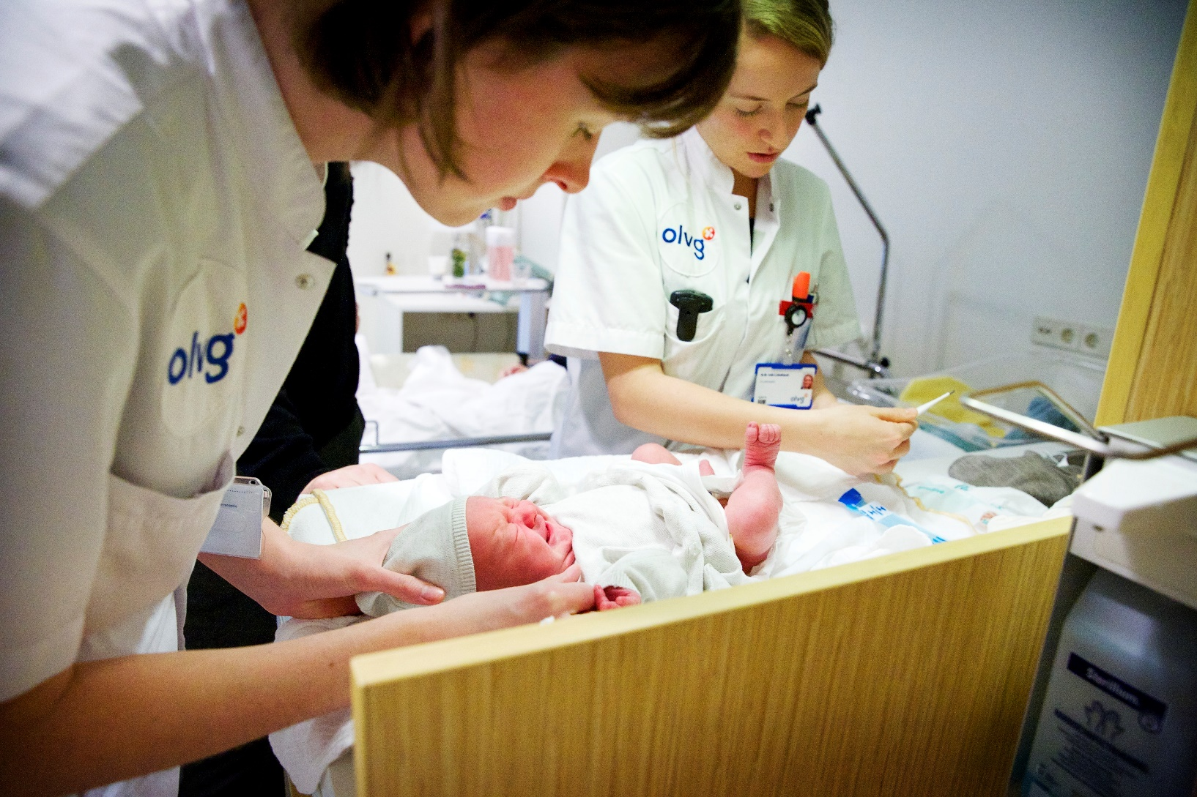
TOGETHER phase: IP-LWP internships
4>
YEAR
Maternity wards
Paediatrics
Rehabilitation centre
Nephrology ward
…
Notes:
leiderschap in eigen professie en in teams herkennen & benutten
belangen van de patiënt kunnen meewegen bij elk besluit
tegenstellingen en conflicten herkennen & hanteren

Slide 12

Interventions
IPE-lessons in Microsoft Teams for interprofessionally mixed groups of multi-located (homebound) students
Years 2+3 (WE phase)
Teacher support program to help (homebound) teachers moderate these virtual classrooms

Slide 13
Interventions: students
Semi-structured instructions
  Uploaded in Teams group channels
Use Teams as a true collaboration platform
Use digital tools for:
  planning meetings, IPC discussion, sharing screen & docs, co-creation integral therapy plan, upload for feedback & assessment
Video-conference skills:
  cam/blur, mic/mute, discussion technique, use of sub channels (breakout rooms), etiquettes, safety issues

Slide 14
Interventions: schedule
 |  | Medicine | ET | OT | PT | Nursing
Year 2
series 1 |  | 144 | 16 | 26 | 117 | 94
series 2 |  | 144 | 17 | 27 | 117 | 91
series 3 |  | 72 | 17 | 27 | 116 | 165
total |  | 360 | 50 | 80 | 350 | 350 | 1190
teachers |  | 16 | 3 | 3 | 6 | 15 | 43
Year 3
series 1 |  | 72 | 8 | 14 | 29 | 60
series 2 |  | 72 | 8 | 14 | 29 | 60
series 3 |  | 72 | 8 | 14 | 29 | 60
series 4 |  | 72 | 8 | 14 | 29 | 60
series 5 |  | 72 | 8 | 14 | 29 | 60
total |  | 360 | 40 | 70 | 145 | 300 | 915
teachers |  | 16 | 3 | 3 | 6 | 15 | 43

Slide 15
Interventions: teacher support program
Didactics:
Narrative of IPC / IPE program
Student’s attitude towards digital education
Drawing attention / addressing individual students
Facilitating groups in sub channels (breakout rooms)
Digital assessment (e.g. autographs)
Digitalisation
Organisation (schedules, DLE)
Technical instructions (2-step authentication, digital preparations)
Chat room for teachers (including help support)

Slide 16
Results: students
…were able to digitally collaborate and
…produce team-based, integral treatment plans
…are comfortable with working in a digital environment
…some recorded their team meeting for absent teacher!
…some felt uncomfortable with the semi-structured format or
…some did not appreciate the authenticity of the learning experience
…some had technical difficulties (2-step authentication)

Slide 17
Results: teachers
…showed steep learning curves
…were able to facilitate IPE in an digital environment
…found it easier to fit into own schedules or self-quarantine
…some prefer digital over physical classes
…found it more challenging than in physical classrooms to monitor interprofessional team dynamics in sub channels (break-out rooms)
…some felt uncertain about their personal digital skills in the beginning

Slide 18
Results: digital environment
Technical:
Different versions of MS Teams in and
Firewall blockades between education institutions
Wi-Fi network instability of participants
Process:
Privacy regulations (digital exchange of name files and logins)
Regulations for archiving digital products and recordings
IT-logistics: life support and helpdesk needed
Costs

Slide 19
Conclusions
Digital IPE is feasible and meaningful
Creation of a real Community of Practice at one platform
  Increased visibility (students and teachers)
  Easier peer support (students and teachers)
  Shared study material and products is nearer to whole team
  Further development by co-creation (both worlds: education and healthcare)
Further study of learning outcomes of students
Attention to digital skills of teachers; facilitators’ development program
At an inter-institutional level, digital education needs to be easier facilitated

Slide 20


Questions
PE

