Slide 1
Using Multidisciplinary Team Meetings to Identify and Manage Patients Classed as Moderately Frail in a Rural General Practice
Francesca Saleh
4th Year Medical Student, Cardiff University School of Medicine
Notes:
Introduce self
Thank you for inviting me today to present my essay about my project “using multidisciplinary meetings to identify and manage patients classed as moderately frail in a rural general practice”

Slide 2
Contents
Background
Introduction
Integration of Primary and Community Care Services
Interprofessional Working
Holistic Care Planning
Personal Academic Gain
Reflection
Conclusion
Questions/Discussion
Notes:
Today I will be covering a number of points, including where the idea for this project came from, frailty, and how integration of primary and community care services developed into interprofessional working and learning

Slide 3
Background
I undertook a year long placement in a rural General Practice (GP)
Borth Surgery has a patient population of 2700, with almost a third of these patients aged over 65 years
Notes:
I’m going to begin this presentation by giving a background picture to this project. I spent my 2019/2020 academic year on a longitudinal integrated clerkship where I was based in Borth Surgery, a rural General Practice in West Wales. This programme was created to give students the opportunity to work in and understand primary care and rural medicine.
Borth Surgery has a patient population of 2700. 30% of which are over 65 years of age, and 16% over 75 years of age. Even though a fair proportion of the population are older, many of these patients are very fit and healthy, however, there are still a lot of patients who have a number of chronic conditions and their management can be complex and challenging
What you can also see on this slide is an example of the electronic Frailty Index. The index calculates how frail an individual is by identifying deficits recorded in their medical record and from this, generates a score. If this score reaches a certain number, the individual is classed as frail and further categorised as mildly, moderately, or severely frail. On this example you can see there is a wide range of deficits that contribute to an individuals score. It takes into account patients diagnoses (such as atrial fibrillation) and recorded symptoms the patient has experienced (such as shortness of breath). The index had already been embedded within clinical system for a couple of years.

Slide 4
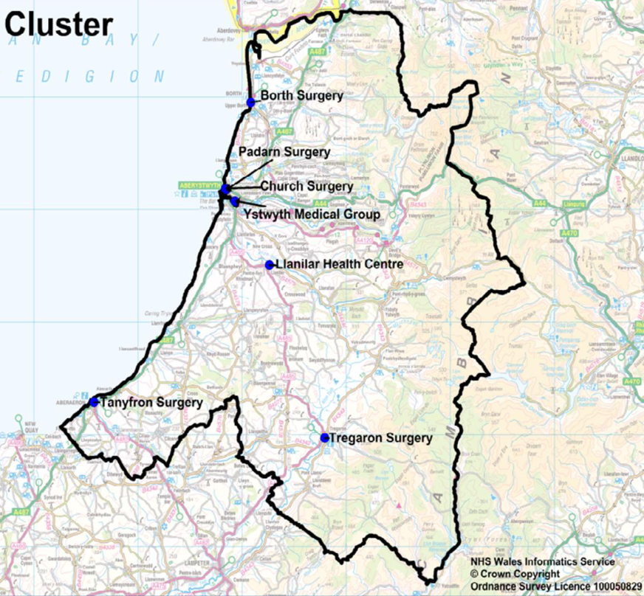
Introduction
Borth Surgery is one of seven Cluster GPs, each of which have their own process of how they manage frail patients
This was deemed inefficient and patients could be incorrectly managed or even missed
Therefore, a formal process was developed to recognise patients at risk of incidents requiring acute medical care
Notes:
Currently, there isn’t a formal process by which this GP cluster oversees their frail patients, meaning each practice identifies, manages and refers patients to the community frailty service differently. This is not an efficient or effective way to use the community services, and so there is a chance patients aren’t being managed as well as they could be, or they’re being missed so they’re not receiving care altogether. The GP Partner who supervised me recognised that this was an issue and was extremely interested in identifying the patients most likely to experience frailty, however, they were unsure where to begin with these patients and how they could be objectively prioritised and so I took this as an opportunity to create a formal process to recognise patients who were classed as moderately frail, identify why these patients were frail and intervene to prevent patients becoming severely frail. It was hoped this would prevent deterioration in health, loss of independence and hospital admissions in these patients, and decrease reliance on social care.
The reason severely frail patients were not managed is because they were already under secondary and community care. Most moderately frail patients were not under any care or monitoring, it was not until they had sustained a serious injury requiring hospital admission, and long-term these patients usually have a decreased quality of life as a result. Therefore, it was decided proactive care planning and discussions between different disciplines was required to prevent this.

Slide 5
Integration of Primary and Community Care Services
Multidisciplinary team (MDT) meetings were set up so each professional could share what they knew about each patient and work together
The Frailty Nurse of the area also joined the meetings as this allowed the GP staff to be aware of which patients were already under Frailty Care
This allowed integration of community and primary care for better co-operation between the different healthcare professionals
Notes:
The doctors recognised that they only have contact with these patients when they require help with a medical issue but the Practice Nurse, Health Care Assistant and District Nurses saw these patients more frequently for regular health check-ups; this was another reason why the MDT meetings were set up, to allow each professional to share what they understood about these patients so everyone could work together instead of independently of one another And with the Frailty Nurse joining the meetings, this allowed better communication for what the GP staff could do further to help the frailty nurse, and who the frailty nurse thought they could actually accept referrals for
This allowed integration of the community and primary care services for better co-operation, and this was especially important due to the rural location of the GP and its patients because there is less availability and accessibility for services in remote and rural areas (Selby-Nelson et al., 2018). Integration allowed each service to be aware of the vulnerable patients and what can be done for them which meant that these patients could be referred to the services they needed without them having to present themselves, so they were not missed

Slide 6
Interprofessional Working
As the meetings went on, different healthcare professionals became involved and were able to bring knowledge and skills from a different perspective to the doctors, nurses, and Health Care Assistant
The Practice Pharmacist educated the doctors and I about improving our prescribing
The shared goal at the end of the meetings was to improve patient care and outcomes, however, it was also found that everyone had a far better understanding of how each professional was able to provide patient care
Notes:
The different healthcare professionals that joined the meetings were the Clinical Lead Nurse of the area, a Pharmacist who had recently joined the GP, 3rd Sector Integration Facilitators, and Social Workers – Community Psychiatric Nurses, Physiotherapists and Occupational Therapists were also keen to join the meetings but unfortunately due to COVID-19, the meetings had to be suspended
Sometimes patients were receiving optimal medical care, but the GP staff had exhausted their resources on how to manage mental health, home, and social issues. but professionals from the 3rd Sector and Social Workers were able to provide alternative management options to assist with the care of these patients
Most of the patients discussed were on at least six repeat prescriptions so the Practice Pharmacist educated the doctors and I about polypharmacy and the effect of anticholinergic medications on frail patients. This meant that patients could be changed to more suitable medications which would decrease their risk of falls, delirium, and cognitive impairment, as well as better prescribing to occur within the GP (Salahudeen et al., 2015)
The addition of these further disciplines meant each professional could bring forward their expertise to address specific issues a patient had, and everyone could work together to creating patient-specific management plans for these complex patients
Everyone’s aim from these meetings was to improve patient care and patients’ quality of life, however, an unexpected finding was that everyone had a far better understanding of what it is each professional could actually do for these patients and that everyone could learn from one another. Different professionals who had not worked together before quickly became one large integrated team.

Slide 7
Holistic Care Planning
When informing patients that they had been discussed in a MDT meeting to improve their quality of life, they felt very well cared for
Each patient had individual care plans created to address and tackle each issue they were facing
Notes:
Patients were very appreciative when informing them they had been discussed in a meeting by many professionals of different disciplines because it was thought they were vulnerable to preventable morbidity.
The creation of individual care plans meant patients believed their health had been considered by a larger team rather than a healthcare professional telling them what to do, and in a holistic manner rather than focusing on the conditions they had. Some of the actions decided upon to help patients was referring them to the Frailty Nurse to assess how they were coping at home to see if they could benefit from District Nursing care and/or Occupational Therapy support, ringing patients to book appointments for medication reviews to ensure what they are taking is actually working and stopping any medications that could be harming them more than benefitting them, or informing patients about local social groups to combat loneliness and improve mental health (Mens Sheds Cymru, 2021)

Slide 8
Personal Academic Gain
Effective communication between professionals to understand roles, plans and expected patient outcome(s) is crucial for efficient teamworking
Better understanding of the roles of each discipline and what they have to offer for patient care
What frailty is and how this knowledge can be applied in the clinical setting
Awareness of the anticholinergic burden
Notes:
Effective communication is especially important if care is to be delivered in a high-quality and safe manner (Leonard and Frankel, 2011), and this isn’t restricted to proactive measures taken by an integrated primary care team. This is also the case in secondary care, for example, in Accident and Emergency departments or in an operating theatre. It is very likely that I’ll have Foundation Year jobs in these departments and if not, I will definitely have to communicate to the teams within these departments; therefore, having exposure to and learning how to effectively communicate and be an effective team member is essential if I am to deliver the best possible care to my patients and progress in my career as a doctor
From these meetings, I have also gained a better understanding of each disciplines role and what skills and resources they are equipped with to care for patients. Better understanding of everyone’s role allows for greater respect within a team and this also improves patient outcomes (Morley and Cashell, 2017). On top of what I have just mentioned, these skills will further allow me to provide the utmost care to my patients
I also learnt a considerable amount about frailty, how it effects patients and its impact on healthcare services. By understanding the pathophysiology behind frailty and why stressors can lead to adverse health outcomes for these patients, I was able to better educate myself on why these patients are so complex to manage and how to overcome this (Dent et al., 2019). This was especially useful earlier on in this academic year when I spent a week on placement in a frailty ward and I was able to apply this knowledge to the patients discussed.
Frailty definition, Clegg et al., 2013.
Furthermore, I gained insight into the anticholinergic burden due to polypharmacy and over-prescribing (Gorup et al., 2018). Anticholinergic medications have been associated with cognitive decline, dizziness, falls, hospitalisations, and frailty itself in older adults. Therefore, frail patients on a number of anticholinergic medications are at a far greater risk of morbidity and mortality (Naharci and Tasci, 2020). Having been made aware of the anticholinergic burden so early on in my medical career and its association with poor outcomes and frailty, I can be more careful with my prescribing when I qualify as a doctor and be able to recognise when adjustments should be made to patient’s prescriptions to decrease the chance of these adverse outcomes

Slide 9
Reflection
This project was created to decrease the risk of frailty-associated accident and injury in vulnerable patients
The collaboration of the different disciplines ensured optimal patient care and that everyone was working towards the same goal
Having the opportunity to work alongside many experienced professionals to increase patients’ quality of life was very rewarding
Learning a variety of invaluable skills that can be used at every stage of my medical career
Notes:
Prior to this project being set up, patients were not recognised by healthcare services as vulnerable because they were not aware of their frailty status and it wasn’t until, for example, the GP would be notified that a patient had been admitted into hospital and had sustained an injury which will permanently affect them, such as a hip fracture due to a fall resulting in loss of mobility so they require carers. The meetings allowed patients to be recognised as at-risk, managed, and then reviewed, as well as to see how each professional was coming along and if they required input from other professionals
Each professional expressed how appreciative they were that these meetings were setup so proactive measures could take place to prevent morbidity of these vulnerable patients and improve outcomes. I felt very pleased to have started a process that could prove effective in decreasing the burden frailty has on the NHS by promoting each discipline to use every skill they had, and even though the project had to abruptly end due to COVID-19, I hope having started this process will encourage all those who were involved to continue a similar approach so other patients do not miss out on the same high-quality care
I developed skills in organising meetings, leadership, balancing multiple different workloads (the GP placement itself and my University studies alongside this project), insight and understanding of the roles of different disciplines, how to effectively prescribe, and most importantly, working alongside professionals from a variety of disciplines to deliver fantastic care to patients as a co-ordinated team. I will be able to apply these skills at every stage of my medical career and regardless of the route I decide to take – whether it be primary or secondary care, medicine or surgery
Overall, it is not enough to just provide what care you can for a patient when you are part of a team, being respectful, understanding, and flexible with other professionals is paramount if the patient is to achieve their best possible outcome

Slide 10
Conclusion
This project proved to be far more successful than anticipated
A variety of different professionals were eager to join the meetings resulting in a considerable improvement in patient care
An interprofessional approach allows for more efficient working than a multidisciplinary approach
Notes:
In conclusion, frailty is a complex multi-factorial condition which means it is difficult to effectively manage (Lacas and Rockwood, 2012) so it only makes sense to have a multitude of disciplines working alongside each other to tackle it
An interprofessional approach to patient care allows for better respect, collaboration, and organisation between professionals, as well as learning valuable skills from one another to enhance ones own practice, as opposed to a multidisciplinary approach where professionals may not be aware of what other professionals could do to assist them or what they could do to assist others
Interprofessional working is crucial in every speciality at every stage and learning and understanding this approach will allow me to improve my practice as a future doctor as an individual and in a team

Slide 11
References
Clegg, A., Young, J., Iliffe, S., Rikkert, M.O. and K. Rockwood. 2013. Frailty in elderly people. The Lancet 381(9868), pp. 752-762. https://doi.org/10.1016/S0140-6736(12)62167-9
Dent, E., Martin, F.C., Bergman, H., Woo, J., Romero-Ortuno, R. and Walston, J.D. 2019. Management of frailty: opportunities, challenges, and future directions. The Lancet 394(10206), pp. 1376-1386. https://doi.org/10.1016/S0140-6736(19)31785-4
Gorup, E., Rifel, J., Petek, M,Š. 2018. Anticholinergic Burden and Most Common Anticholinergic-acting Medicines in Older General Practice Patients. Zdr Varst 57(3), pp. 140-147. https://doi.org/10.2478/sjph-2018-0018
Kilner, E. and Sheppard, L.A. 2010. The role of teamwork and communication in the emergency department: A systematic review. International Emergency Nursing 18(3), pp. 127-137. https://doi.org/10.1016/j.ienj.2009.05.006
Lacas, A. and Rockwood, K. 2012. Frailty in primary care: a review of its conceptualization and implications for practice. BMC Medicine 10(4). https://doi.org/10.1186/1741-7015-10-4
Leonard, M.W. and Frankel, A.S. 2011. Role of Effective Teamwork and Communication in Delivering Safe, High‐Quality Care. Mt Sinai J Med 78, pp. 820-826. https://doi.org/10.1002/msj.20295
Mens Sheds Cymru. 2021. What is a Men’s Shed? Available at: https://www.mensshedscymru.co.uk/what-is-a-mens-shed/ [Accessed: 1st May 2021]
Morley, L. and Cashell, A. 2017. Collaboration in Health Care. Journal of Medical Imaging and Radiation Sciences 48(2), pp. 207-216. https://doi.org/10.1016/j.jmir.2017.02.071
Naharci, M.I. and Tasci, I. 2020. Frailty status and increased risk for falls: The role of anticholinergic burden. Archives of Gerontology and Geriatrics 90, 104136. https://doi.org/10.1016/j.archger.2020.104136.
Salahudeen, M.S., Duffull, S.B. and Nishtala, P.S. 2015. Anticholinergic burden quantified by anticholinergic risk scales and adverse outcomes in older people: a systematic review. BMC Geriatr 15(31). https://doi.org/10.1186/s12877-015-0029-9
Selby-Nelson, E.M., Bradley, J.M., Schiefer, R.A. and Hoover-Thompson, A. 2018. Primary care integration in rural areas: A community-focused approach. Families, Systems, & Health 36(4), pp. 528-534. https://doi.org/10.1037/fsh0000352

Slide 12
Questions/Discussion
Thank you!

