Slide 1
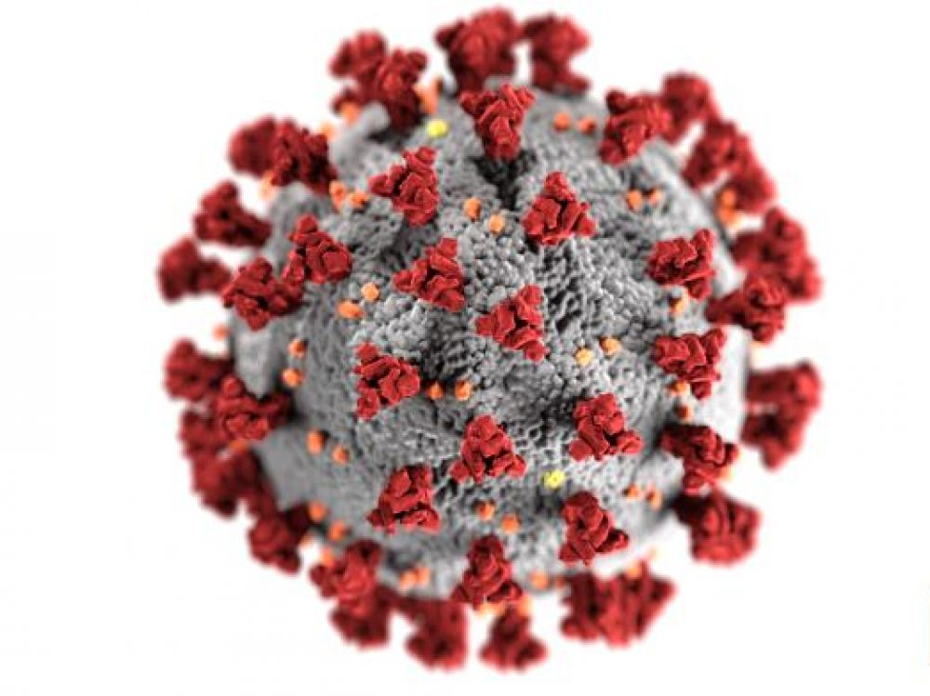
The COVID-19 pandemic in Sri Lanka: Multi-sectoral Healthcare and Other Workers on the Front Line – Risk and Challengers
Chulani Herath (PhD), Department of Psychology & Counselling,
Faculty of Health Sciences, The Open University of Sri Lanka

Slide 2
Introduction
Coronavirus (COVID-19) pandemic is spreading across the world and Sri Lanka is no exception.
First COVID-19 patient in Sri Lanka was reported on 27 January 2020 and virus seemed active in Sri Lanka with the detection of second patient on 11 March 2020.
Among the healthcare workers also, the front-line workers involved directly in handling these patients are at greater risk than others.
The objective of this paper is to describe risks and challengers facing by multi sectoral workers on the front line in Sri Lanka.

Slide 3
COVID – 19 Sri Lanka Approach
Strategy in combatting COVID – 19 is focuses on four lines of operations
Presidential Task Force established to combat COVID – 19 in Sri Lanka.
The membership of the Task Force is 40 including Provincial Governors, several Secretaries to Ministries, Commanders of Tri-Forces, security chiefs including Acting Inspector General of Police, Chairmen of several Departments, Corporations and Authorities and District and Divisional Secretaries.
The Government Sri Lanka established the National Operation center for prevention of COVID -19 outbreak to forefront combined operations of combatting.
Intelligence service, health sector, defense forces, police were kept ready to act in any outbreak.

Slide 4
Multi-sectoral Healthcare and Other Workers on the Front Line
Approximately 6,000 health care workers engaged as direct workers, as contracted workers (contractors, subcontractors), or civil servants.
Health care workers may carry out a range of activities,
For example, assessing, triaging and treating COVID-19 patients and workers; establishing public health reporting procedures of suspect and confirmed cases; providing or reinforcing accurate infection prevention and control and public health information, including for concerned workers.

Slide 5
Risks and challenges faced by the Healthcare workers in frontline
Clearly, those workers involved in healthcare are at the front line in terms of risk of infection and death.
A physically and mentally healthy and well-equipped healthcare workforce is vital to a country’s capability to manage COVID-19 cases effectively and lessons can be learnt from the SARS epidemic to introduce novel working arrangements to help protect healthcare workers from infection.
Apart from the direct infection risks arising from close contact with patients and/or potentially infectious co-workers during the COVID-19 pandemic, healthcare workers are also under increasing stress and mental health risks.

Slide 6
The number of infected and severely ill patients is escalating as well as the number of exposed healthcare workers who are under self-quarantine, either because they have been infected with COVID-19 or have been in contact with a case. This is leading to a much greater workload and stress for those left in the healthcare workforce and a serious weakening of the health service provided.
Mental health risks are further exacerbated by reported shortages of protective equipment for healthcare workers in many parts of the world. There is an urgent need for measures to maintain the mental health of healthcare workers in such stressful situations.

Slide 7
Apart from the direct health effects on workers from COVID-19 infection, there will be many flow- on effects which will have an impact on workers’ health.
Contributing to these economic effects are the temporary closing of many factories and businesses, and the reduction in the workforce at other businesses resulting in many workers losing their jobs, at least temporarily.
Lack of employment, even when temporary, can lead to mental health decline, and these effects are very likely to be exacerbated by the sudden, unexpected, and widespread onset of the COVID-19 pandemic and associated job losses.
Even among those fortunate workers who are still employed, prolonged teleworking may lead to mental health problems due to long- term social isolation and lack of workplace interaction.
More research is needed on the risks to health from COVID-19 among healthcare and other workers at high risk of infection.

